Slide 1
What is a (personal) computer?

Slide 2
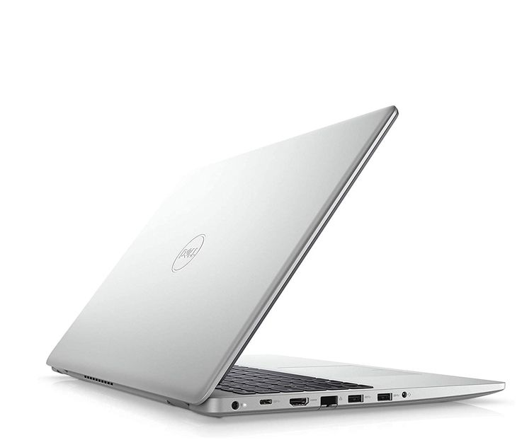
Computers (Case)
Desktop
Laptop

Slide 3
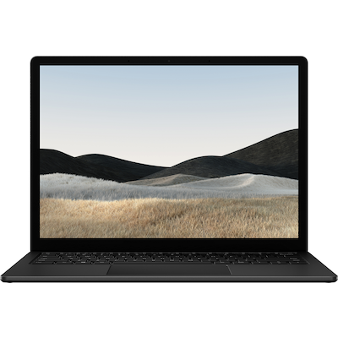
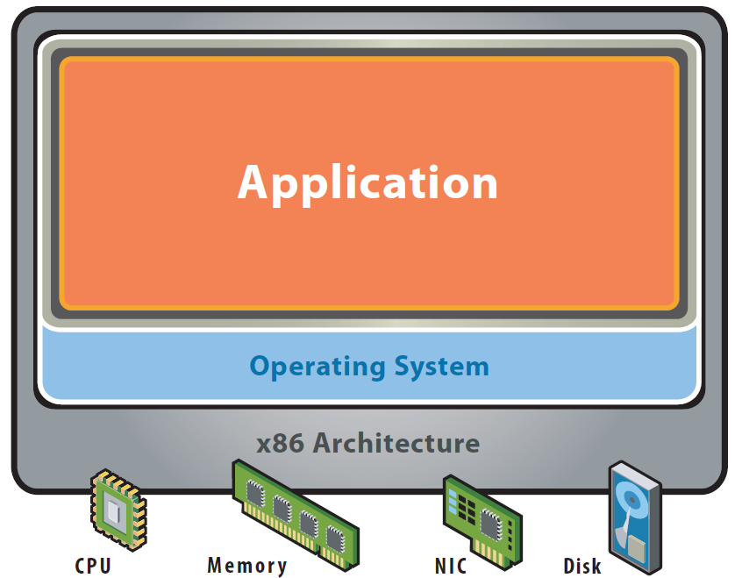
Basic components and layers 1/2
Hardware
Processor (CPU)
Memory (RAM)
Network interface card (NIC)
Hard drive / Storage (SSD / HDD)
Graphics processing unit (GPU)

Slide 4
Basic components and layers 2/2
BIOS / UEFI
Typically called BIOS, but to be exact new computers have UEFI (Unified Extensible Firmware Interface)
Responsible for booting the device and interpreting the data between the operating system and the iron
Operation system
MacOS, Linux, Windows
The program what you want to use

Slide 5
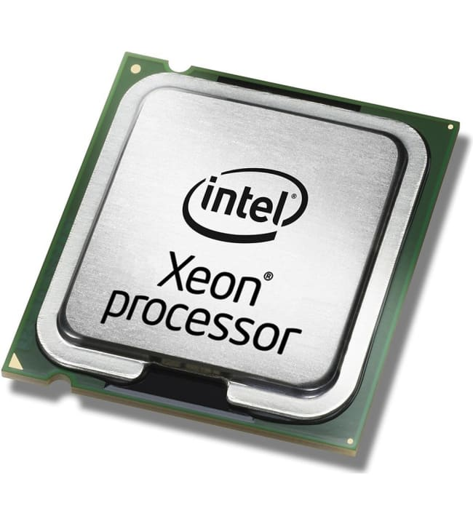
Processor (CPU)
Determines the computing (calculation) power of the device in general use case
Three main branches
x86-64 (AMD, Intel)
ARM (M1, Raspberry pi)
Risc (“Free ARM”)
Determining power is not easy to calculate, but the basic principle is “Number of cores * clock frequency = power”
However, efficiency is not that easy because not all programs take advantage of cores and newer processors do more per clock cycle.

Slide 6
Memory
Indirectly determines the number of concurrent processes on the device.
Memory is required to input data to the CPU. If the device is low on memory, not much data can be input to the processor.
If the amount of data stays below the amount of memory, there will be no bottlenecks.
If the amount of data is larger, then you will have to use the Page File, i.e. the hard disk, as a temporary storage space. This slows down the processing of data VERY significantly

Slide 7
Storage (SSD / HDD)
A device that stores the information we want to keep when the device is turned off.
Can be roughly divided into two categories
HDD, or mechanical hard disks. Nicknamed Spinning Rust
SSD, Similar microcircuits are used, for example, in USB sticks.
There are several interface standards for move data through storage connectors. M2, IDE, SATA, PCIe, etc. and ways (languages)

Slide 8
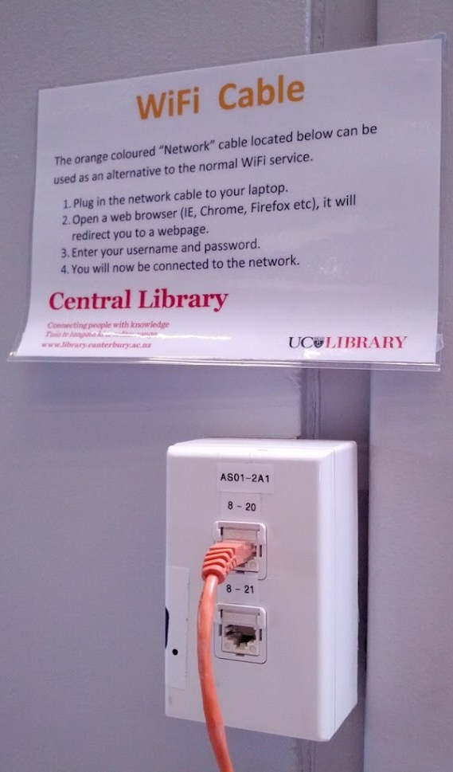
Network interface card (NIC)
This is typically either a network card (eth) or a wireless network device (wlan).
For a normal user, this is as important as a faucet. If it works, it works, and you don’t think how it works.
Have you wondered where and how the water comes into your house?

Slide 9
Graphics processing unit (GPU)
GPU is a specialized component(s) designed to accelerate the creation of images to a display device.
Basic types are
Integrated graphics
Dedicated graphics
All modern computers have a at least Integrated graphics to power typical desktop environments and basic games
Dedicated graphics allow to do complex AI calculations and modern triple A games

Slide 10
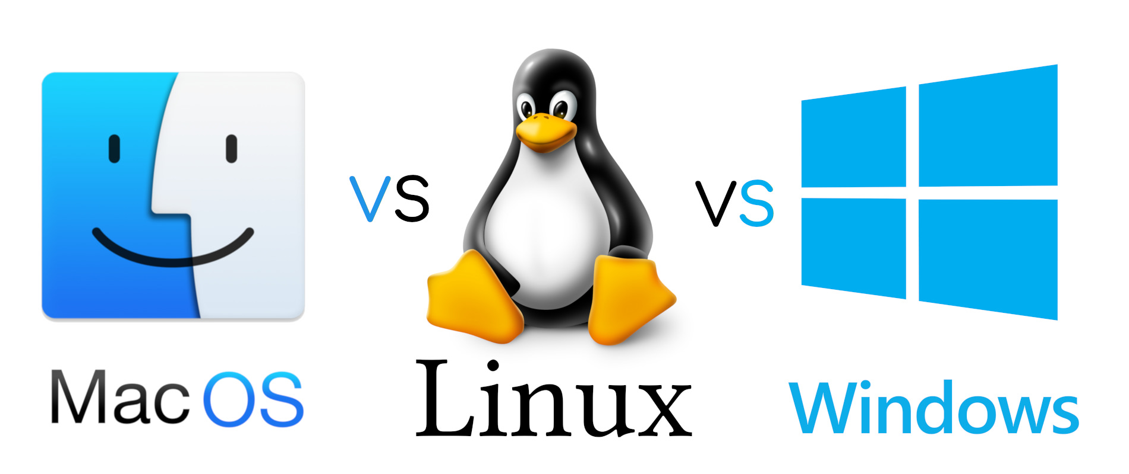
Operation system
Basic interface to use and run software on your computer. Can be changed within certain limits.
For the typical user, it does not matter which operating system you are running, as the basic programs works on almost all systems.
Most typical operation system is Windows 10/11

Slide 11
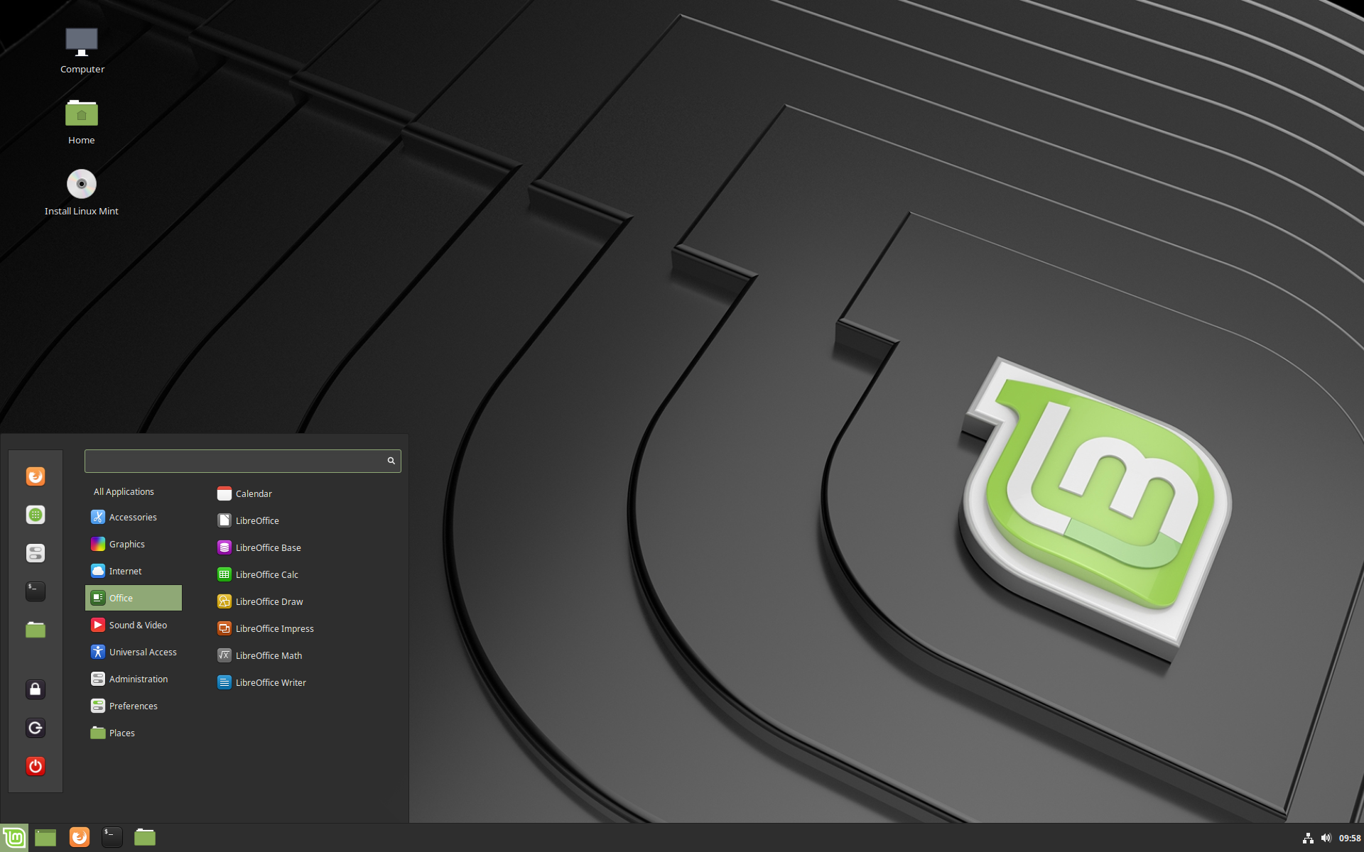
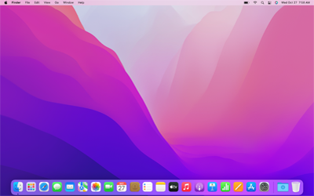
Graphical interface (GUI)
Typical user interface is Graphical user interface (GUI). It relays on use of mouse and keyboard.
It’s the default interface for customer orient devices
Typically GUI are expensive to build and update.

Slide 12
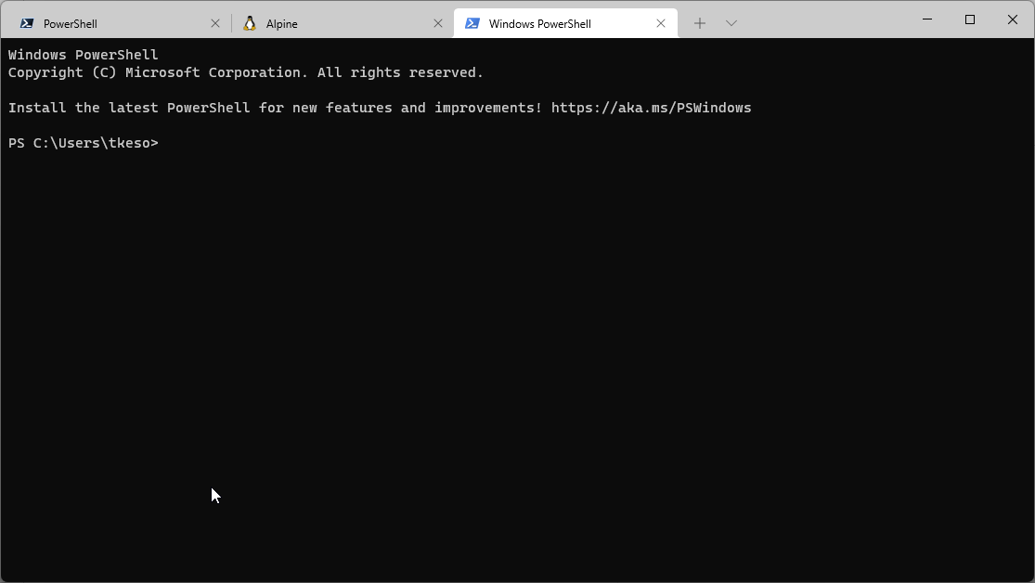
Command-line interface (CLI)
A command-line interface (CLI) processes commands to a computer program in the form of lines of text.
Command-line interface is called a shell

Slide 13
GUI versus CLI
GUI
+ User-friendly
+ Visual feedback to user
+ Can be build over CLI application
Expensive to make
Typically just managing just one computer and one task
CLI
+ Easy to build and modify
+ Can be easily transmitted to user to user
+ Can be applied to one or multiply computers
Require user to learn command and inputs
No graphics

Slide 14
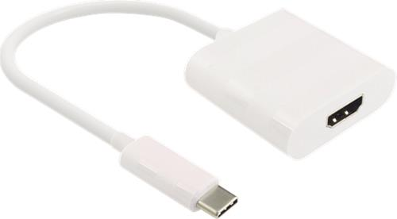
Recommendations for the computer or workstation for schoolwork
Processor: Intel i5 or AMD Ryzen 5
RAM: at least 16 Gb
GPU: at least Intel HD/UHD Graphics or similar
Display resolution: minimum 1920 x 1080
Storage space: at least a 500 Gb SSD
HDMI port (type A) or HDMI adapter (type A)
Windows 10 64-bit
It’s good to have a secondary monitor especially when working/learning from home.

